Slide 1
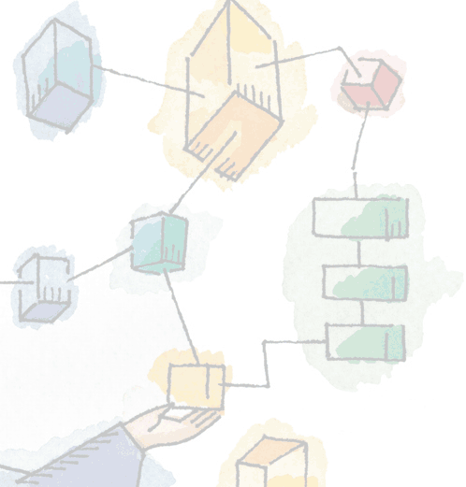
Chapter 10
Multiprocessor and Real-Time Scheduling

Slide 2
Classifications of
Multiprocessor Systems
Loosely coupled processors,
  Each has their memory & I/O channels
Functionally specialized processors
  Controlled by a master processor
  Such as I/O processor
Tightly coupled multiprocessing
  Processors share main memory
  Controlled by operating system
Notes:
We can classify multiprocessor systems as follows:
• Loosely coupled or distributed multiprocessor, or cluster:
Consists of a collection of relatively autonomous systems, each processor having its own main memory and I/O channels.
• Functionally specialized processors:
An example is an I/O processor.
In this case, there is a master, general-purpose processor; specialized processors are controlled by the master processor and provide services to it.
• Tightly coupled multiprocessing:
Consists of a set of processors that share a common main memory and are under the integrated control of an operating system.

Slide 3
Granularity
Or frequency of synchronization, between processes in a system.
Five categories, differing in granularity:
  Independent Parallelism
  Coarse Parallelism
  Very Coarse-Grained Parallelism
  Medium-Grained Parallelism
  Fine-Grained Parallelism
Notes:
A good way of characterizing multiprocessors and placing them in context with other architectures is to consider the synchronization granularity, or frequency of synchronization, between processes in a system.
We can distinguish five categories of parallelism that differ in the degree of granularity.

Slide 4
Independent Parallelism
No explicit synchronization among processes
Separate application or job
Example is time-sharing system
Notes:
With independent parallelism, there is no explicit synchronization among processes.
Each represents a separate, independent application or job.
A typical use of this type of parallelism is in a time-sharing system.
Each user is performing a particular application, such as word processing or using a spreadsheet.
The multiprocessor provides the same service as a multiprogrammed uniprocessor.
Because more than one processor is available, average response time to the users will be less.

Slide 5
Coarse and Very
Coarse-Grained Parallelism
Synchronization among processes at a very gross level
Good for concurrent processes running on a multiprogrammed uniprocessor
  Can by supported on a multiprocessor with little change
Notes:
With coarse and very-coarse grained parallelism, there is synchronization among processes, but at a very gross level.
This kind of situation is easily handled as a set of concurrent processes running on a multiprogrammed uniprocessor and can be supported on a multiprocessor with little or no change to user software.

Slide 6
Medium-Grained
Parallelism
Single application is a collection of threads
Threads usually interact frequently, affecting the performance of the entire application
Notes:
From chapt 4, we saw that a single application can be effectively implemented as a collection of threads within a single process.
In this case, the programmer must explicitly specify the potential parallelism of an application.
Typically, there will need to be rather a high degree of coordination and interaction among the threads of an application, leading to a medium-grain level of synchronization.
Because the various threads of an application interact so frequently, scheduling decisions concerning one thread may affect the performance of the entire application.

Slide 7
Fine-Grained
Parallelism
Highly parallel applications
Specialized and fragmented area
Notes:
Fine-grained parallelism represents a much more complex use of parallelism than is found in the use of threads.
Although much work has been done on highly parallel applications, this is so far a specialized and fragmented area, with many different approaches.

Slide 8

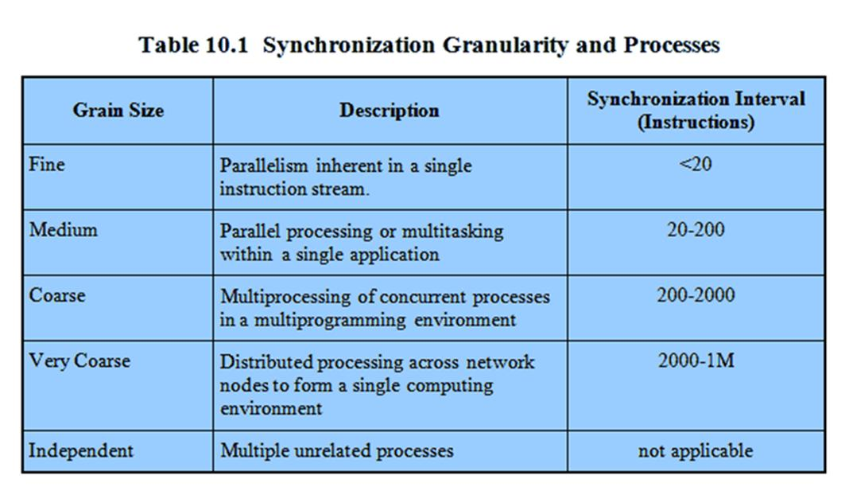
Synchronization
Granularity and Processes

Slide 9
Scheduling
Design Issues
Scheduling on a multiprocessor involves three interrelated issues:
  Assignment of processes to processors
  Use of multiprogramming on individual processors
  Actual dispatching of a process
The approach taken will depend on the degree of granularity of applications and the number of processors available
Notes:
Scheduling on a multiprocessor involves three interrelated issues:
• The assignment of processes to processors
• The use of multiprogramming on individual processors
• The actual dispatching of a process
It is important to keep in mind that the approach taken will depend, in general, on the degree of granularity of the applications and on the number of processors available.

Slide 10
Assignment of
Processes to Processors
Assuming all processors are equal, it is simplest to treat processors as a pooled resource and assign process to processors on demand.
  Should the assignment be static or dynamic though?
Dynamic Assignment
  threads are moved for a queue for one processor to a queue for another processor;
Notes:
Assuming that the architecture of the multiprocessor is uniform, in the sense that no processor has a particular physical advantage with respect to access to main memory or to I/O devices,
then the simplest scheduling approach is to treat the processors as a pooled resource
and assign processes to processors on demand.
The question then arises as to whether the assignment should be static or dynamic.
With Dynamic Assignment, threads are moved for a queue for one processor to a queue for another processor;
Linux uses this approach.

Slide 11
Static Assignment
Permanently assign process to a processor
  Dedicate short-term queue for each processor
  Less overhead
  Allows the use of ‘group’ or ‘gang’ scheduling (see later)
But may leave a processor idle, while others have a backlog
  Solution: use a common queue
Notes:
If a process is permanently assigned to one processor from activation until its completion,
then a dedicated short-term queue is maintained for each processor.
An advantage of this approach is that there may be less overhead in the scheduling function, because the processor assignment is made once and for all.
Also, the use of dedicated processors allows a strategy known as group or gang scheduling, as discussed later.
A disadvantage is that one processor can be idle, with an empty queue, while another processor has a backlog.
To prevent this situation, a common queue can be used.
All processes go into one global queue and are scheduled to any available processor.

Slide 12
Assignment of
Processes to Processors
Both dynamic and static methods require some way of assigning a process to a processor
Two methods:
  Master/Slave
  Peer
There are of course a spectrum of approaches between these two extremes.

Slide 13
Master / Slave
Architecture
Key kernel functions always run on a particular processor
Master is responsible for scheduling
Slave sends service request to the master
Disadvantages
  Failure of master brings down whole system
  Master can become a performance bottleneck
Notes:
Key kernel functions of the operating system always run on a particular processor.
The other processors may only execute user programs.
The master is responsible for scheduling jobs.
Once a process is active, if the slave needs service (e.g., an I/O call), it must send a request to the master and wait for the service to be performed.
There are two disadvantages to this approach:
A failure of the master brings down the whole system,
The master can become a performance bottleneck.

Slide 14
Peer architecture
Kernel can execute on any processor
Each processor does self-scheduling
Complicates the operating system
  Make sure two processors do not choose the same process
Notes:
The kernel can execute on any processor,
and each processor does self-scheduling from the pool of available processes.
This approach complicates the operating system.
lost from the queue.
The operating system must ensure that two processors do not choose the same process and that the processes are not somehow
Techniques must be employed to resolve and synchronize competing claims to resources.

Slide 15
Process Scheduling
Usually processes are not dedicated to processors
A single queue is used for all processes
Or multiple queues are used for priorities
  All queues feed to the common pool of processors
Notes:
Usually, processes are not dedicated to processors.
Instead, a single queue is used for all processors,
or if some sort of priority scheme is used, there are multiple queues based on priority, all feeding into the common pool of processors.
We can view the system as being a multiserver queuing architecture.

Slide 16
Thread Scheduling
Threads execute separate from the rest of the process
An application can be a set of threads that cooperate and execute concurrently in the same address space
Notes:
With threads, the concept of execution is separated from the rest of the definition of a process.
An application can be implemented as a set of threads, which cooperate and execute concurrently in the same address space.
Threads on a uniprocessor system can be used as a program structuring aid and to overlap I/O with processing.
However, the full power of threads becomes evident in a multiprocessor system.
Threads can be used to exploit true parallelism in an application.
If the various threads of an application are simultaneously run on separate processors, dramatic gains in performance are possible.

Slide 17
Approaches to
Thread Scheduling
Many proposals exist but four general approaches stand out:
  Load Sharing
  Gang Scheduling
  Dedicated processor assignment
  Dynamic scheduling
Notes:
Among the many proposals for multiprocessor thread scheduling and processor assignment, four general approaches stand out:
Load Sharing
Gang Scheduling
Dedicated processor assignment
Dynamic scheduling

Slide 18
Load Sharing
Processes are not assigned to a particular processor
Load is distributed evenly across the processors
No centralized scheduler required
The global queue can be organized
Notes:
Load Sharing:
Processes are not assigned to a particular processor.
A global queue of ready threads is maintained, and each processor, when idle, selects a thread from the queue.
The term load sharing is used to distinguish this strategy from load-balancing schemes in which work is allocated on a more permanent basis
Advantages:
The load is distributed evenly across the processors, assuring that no processor is idle while work is available to do.
No centralized scheduler is required; when a processor is available, the scheduling routine of the operating system is run on that processor to select the next thread.
The global queue can be organized and accessed using any of the schemes discussed in Chapter 9.

Slide 19
Disadvantages of
Load Sharing
Central queue needs mutual exclusion
  Can lead to bottlenecks
Preemptive threads are unlikely resume execution on the same processor
If all threads are in the global queue, all threads of a program will not gain access to the processors at the same time
Notes:
The central queue occupies a region of memory that must be accessed in a manner that enforces mutual exclusion.
Thus, it may become a bottleneck if many processors look for work at the same time.
When there is only a small number of processors, this is unlikely to be a noticeable problem. But when the multiprocessor consists of dozens or even hundreds of processors, the potential for bottleneck is real.
Preempted threads are unlikely to resume execution on the same processor.
If each processor is equipped with a local cache, caching becomes less efficient.
If all threads are treated as a common pool of threads, it is unlikely that all of the threads of a program will gain access to processors at the same time.
If a high degree of coordination is required between the threads of a program, the process switches involved may seriously compromise performance.

Slide 20
Gang Scheduling
A set of related threads is scheduled to run on a set of processors at the same time
Parallel execution of closely related processes may reduce overhead such as process switching and synchronization blocking.
Notes:
A set of related threads is scheduled to run on a set of processors at the same time, on a one-to-one basis.
If closely related processes execute in parallel, synchronization blocking may be reduced, less process switching may be necessary, and performance will increase.
Scheduling overhead may be reduced because a single decision affects a number of processors and processes at one time.

Slide 21
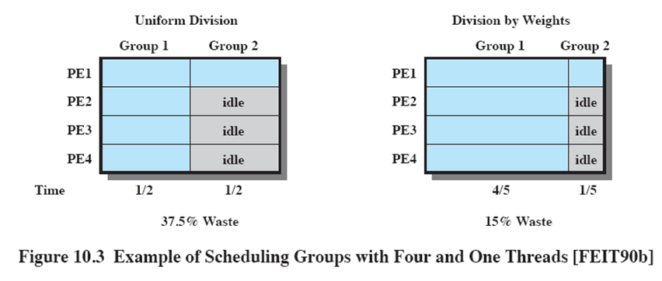
Example
Scheduling Groups
Notes:
The use of gang scheduling creates a requirement for processor allocation.
Consider an example in which there are two ap plications,
one with four threads and one with one thread.
Using uniform time allocation wastes 37.5% of the processing resource,
because when the single-thread application runs, three processors are left idle.
If there are several one-thread applications, these could all be fit together to increase processor utilization.
If that option is not available, an alternative to uniform scheduling is scheduling that is weighted by the number of threads.
Thus, the four-thread application could be given four-fifths of the time and the one-thread application given only one-fifth of the time, reducing the processor waste to 15%.

Slide 22
Dedicated Processor Assignment
When application is scheduled, its threads are assigned to a processor
Some processors may be idle
  No multiprogramming of processors
But
  In highly parallel systems processor utilization is less important than effectiveness
  Avoiding process switching speeds up programs
Notes:
Each program is allocated a number of processors equal to the number of threads in the program, for the duration of the program execution.
When the program terminates, the processors return to the general pool for possible allocation to another program.
This approach would appear to be extremely wasteful of processor time.
If a thread of an application is blocked waiting for I/O or for synchronization with another thread, then that thread’s processor remains idle: there is no multiprogramming of processors.
But
1) In a highly parallel system, with tens or hundreds of processors, each of which represents a small fraction of the cost of the system, processor utilization is no longer so important as a metric for effectiveness or performance.
2) The total avoidance of process switching during the lifetime of a program should result in a substantial speedup of that program.

Slide 23
Dynamic Scheduling
Number of threads in a process are altered dynamically by the application
  This allows the OS to adjust the load to improve utilization
Notes:
The number of threads in a process can be altered during the course of execution
allowing the operating system to adjust the load to improve utilization.

Slide 24
Real-Time Scheduling
Correctness of the system depends not only on the logical result of the computation but also on the time at which the results are produced
Tasks or processes attempt to control or react to events that take place in the outside world
These events occur in “real time” and tasks must be able to keep up with them
Notes:
Real-time computing may be defined as that type of computing in which the correctness of the system depends not only on the logical result of the computation but also on the time at which the results are produced.
A real-time system is defined by what is meant by a real-time process, or task.
In general, in a real-time system, some of the tasks are real-time tasks, and these have a certain degree of urgency to them.

Slide 25
Hard vs Soft
“Hard “ real time task:
  One that must meet a deadline
“Soft” real time task
  Has a deadline which is desirable but not mandatory
Notes:
A hard real-time task is one that must meet its deadline;
otherwise it will cause unacceptable damage or a fatal error to the system.
A soft real-time task has an associated deadline that is desirable but not mandatory; it still makes sense to schedule and complete the task even if it has passed its deadline.

Slide 26
Periodic vs Aperiodic
Periodic tasks
  Are completed regularly, once per period T or exactly T units apart
Aperiodic tasks
  Has a deadline by which it must finish or start or it may have a constraint on both start and finish time
Notes:
A periodic task, the requirement may be stated as “once per period T” or “exactly T units apart.”
An aperiodic task has a deadline by which it must finish or start, or it may have a constraint on both start and finish time.

Slide 27
Real-Time Systems
Control of laboratory experiments
Process control in industrial plants
Robotics
Air traffic control
Telecommunications
Military command and control systems

Slide 28
Characteristics of
Real Time Systems
Real time systems have requirements in five general areas:
  Determinism
  Responsiveness
  User control
  Reliability
  Fail-soft operation
Notes:
Real-time operating systems can be characterized as having unique requirements in
five general areas:
• Determinism
• Responsiveness
• User control
• Reliability
• Fail-soft operation

Slide 29
Determinism
Operations are performed at fixed, predetermined times or within predetermined time intervals
Concerned with how long the operating system delays before acknowledging an interrupt and there is sufficient capacity to handle all the requests within the required time
Notes:
An operating system is deterministic to the extent that it performs operations at fixed, predetermined times or within predetermined time intervals.
One useful measure of the ability of an operating system to function deterministically is the maximum delay from the arrival of a high-priority device interrupt to when servicing begins.
In non-real-time operating systems, this delay may be in the range of tens to hundreds of milliseconds,
While in real-time operating systems that delay may have an upper bound of anywhere from a few microseconds to a millisecond.

Slide 30
Responsiveness
How long, after acknowledgment, it takes the operating system to service the interrupt
Responsiveness includes:
  Amount of time to begin execution of the interrupt
  Amount of time to perform the interrupt
  Effect of interrupt nesting
Notes:
Responsiveness is concerned with how long, after acknowledgment, it takes an operating system to service the interrupt.
Aspects of responsiveness include:
1. The amount of time required to initially handle the interrupt and begin execution of the interrupt service routine (ISR).
2. The amount of time required to perform the ISR.
3. The effect of interrupt nesting.

Slide 31
User control
It is essential to allow the user fine-grained control over task priority.
May allow user to specify things such as paging or process swapping
Disks transfer algorithms to use
Rights of processes
Notes:
In a real-time system it is essential to allow the user fine-grained control over task priority.
The user should be able to distinguish between hard and soft tasks and to specify relative priorities within each class.
A real-time system may also allow the user to specify such characteristics as
the use of paging or process swapping,
what processes must always be resident in main memory,
what disk transfer algorithms are to be used,
what rights the processes in various priority bands have, and so on.

Slide 32
Characteristics
Reliability
  Degradation of performance may have catastrophic consequences
  Financial loss
  Major equipment damage
  Loss of life
Fail-soft operation
  Ability of a system to fail in such a way as to preserve as much capability and data as possible
  Stability is important – if all deadlines are impossible, critical deadlines still meet.
Notes:
Reliability is typically far more important for real-time systems than non-real-time systems
A real-time system is responding to and controlling events in real time.
Loss or degradation of performance may have catastrophic consequences, ranging from financial loss to major equipment damage and even loss of life.
Fail-soft operation is a characteristic that refers to the ability of a system to fail in such a way as to preserve as much capability and data as possible.
An important aspect of fail-soft operation is referred to as stability.
A real-time system is stable if, in cases where it is impossible to meet all task deadlines, the system will meet the deadlines of its most critical, highest-priority tasks, even if some less critical task deadlines are not always met.

Slide 33
Features of
Real-Time OS
Fast process or thread switch
Small size(minimal functionality
Ability to respond to external interrupts quickly
Multitasking with interprocess communication tools such as semaphores, signals, and events

Slide 34
Features of
Real-Time OS cont…
Use of special sequential files that can accumulate data at a fast rate
Preemptive scheduling base on priority
Minimization of intervals during which interrupts are disabled
Delay tasks for fixed amount of time
Special alarms and timeouts

Slide 35
Heart of real time system is the short term task scheduler
All hard real time tasks complete(or start ) by their deadline
And soft real time tasks also complete (or start ) by their deadline

Slide 36
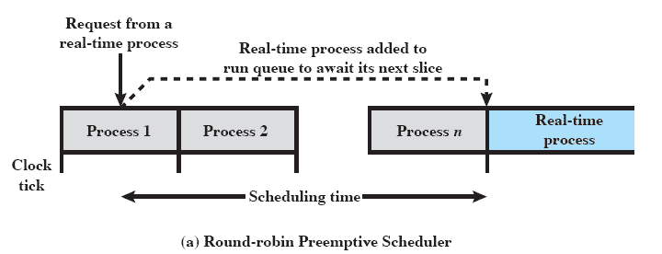
Round Robin scheduling unacceptable
Notes:
In a preemptive scheduler that uses simple round-robin scheduling, a real-time task would be added to the ready queue to await its next time slice, as illustrated in Figure 10.5a.
In this case, the scheduling time will generally be unacceptable for real-time applications.

Slide 37
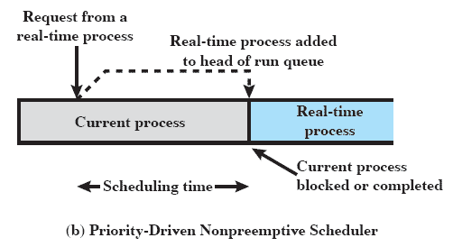
Priority driven unacceptable
Notes:
In a nonpreemptive scheduler, we could use a priority scheduling mechanism, giving real-time tasks higher priority.
In this case, a real-time task that is ready would be scheduled as soon as the current process blocks or runs to com-
pletion (Figure 10.5b).
This could lead to a delay of several seconds if a slow, low-priority task were executing at a critical time.
Again, this approach is not acceptable.

Slide 38
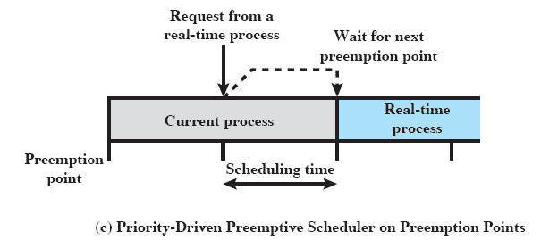
Combine priorities with clock-based interrupts
Notes:
A more promising approach is to combine priorities with clock-based interrupts.
Preemption points occur at regular intervals.
When a preemption point occurs, the currently running task is preempted if a higher-priority task is waiting.
This would include the preemption of tasks that are part of the operating system kernel.
Such a delay may be on the order of several milliseconds.
While this last approach may be adequate for some real-time applications, it will not suffice for more demanding applications.

Slide 39
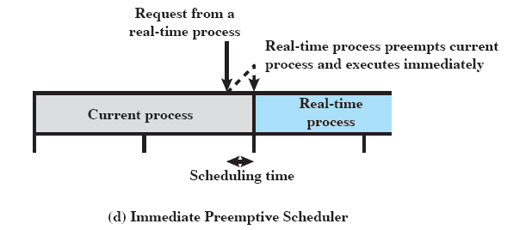
Immediate Preemption
Notes:
For more demanding applications, the approach that has been taken is sometimes referred to as immediate preemption.
In this case, the operating system responds to an interrupt almost immediately, unless the system is in a critical-code lockout section.
Scheduling delays for a real-time task can then be reduced to 100 "s or less.

Slide 40
Classes of Real-Time Scheduling Algorithms
Static table-driven
  Task execution determined at run time
  Applicable to tasks that are periodic
  Input of the analysis consists of the periodic arrival time, execution time, periodic ending deadline and relative priority of each task
  Any change to any task requirements requires that the schedule be redone
  Earliest deadline first is one of the example
Notes:
Static table-driven approaches:
These perform a static analysis of feasible schedules of dispatching.
The result of the analysis is a schedule that determines, at run time, when a task must begin execution.
Static priority-driven preemptive approaches:
Again, a static analysis is performed, but no schedule is drawn up.
The analysis is used to assign priorities to tasks, so that a traditional priority-driven preemptive scheduler can be used.
Dynamic planning-based approaches:
Feasibility is determined at run time (dynamically) rather than offline prior to the start of execution statically).
An arriving task is accepted for execution only if it is feasible to meet its time constraints.
One of the results of the feasibility analysis is a schedule or plan that is used to decide when to dispatch this task.
Dynamic best effort approaches:
No feasibility analysis is performed.
The system tries to meet all deadlines and aborts any started process whose deadline is missed.

Slide 41
Static priority-driven preemptive
  Traditional priority-driven scheduler is used
  In real time priority assignment is related to the time constraints associated with each task
  Example rate monotonic algorithm which assigns static priorities to tasks based on the length of their periods

Slide 42
Dynamic planning-based
  Feasibility determined at run time
  After a task arrives but before its execution begins an attempt is made to create a schedule that contains the previously scheduled tasks as well as the new arrival

Slide 43
Dynamic best effort
  No feasibility analysis is performed
  With this type of scheduling ,until a deadline arrives or until the task completes we do not know whether a timing constraint will be met.
  This is the major disadvantage
  Advantage is easy to implement

Slide 44
Deadline Scheduling
Real-time applications are not concerned with speed but with completing tasks
Notes:
Real-time applications are generally not concerned with sheer speed but rather with completing (or starting) tasks at the most valuable times, neither too early nor too late, despite dynamic resource demands and conflicts, processing overloads, and hardware or software faults.
Therefore, priorities provide a crude tool and do not capture the requirement of completion (or initiation) at the most valuable time.

Slide 45
Deadline Scheduling
Information used
  Ready time
  Starting deadline
  Completion deadline
  Processing time
  Resource requirements
  Priority
  Subtask scheduler
Notes:
Ready time:
Time at which task becomes ready for execution.
Starting deadline:
Time by which a task must begin.
Completion deadline:
Time by which task must be completed.
Processing time:
Time required to execute the task to completion.
Resource requirements:
Set of resources (other than the processor) required by the task while it is executing.
Priority:
Relative importance of the task.
Hard real-time tasks may have an “absolute” priority, with the system failing if a deadline is missed.
If the system is to continue to run no matter what, then both hard and soft real-time tasks may be assigned relative priorities as a guide to the scheduler.
Subtask structure:
A task may be decomposed into a mandatory subtask and an optional subtask.
Only the mandatory subtask possesses a hard deadline.

Slide 46
Preemption
When starting deadlines are specified, then a nonpreemptive scheduler makes sense.
E.G. if task X is running and task Y is ready, there may be circumstances in which the only way to allow both X and Y to meet their completion deadlines is to preempt X, execute Y to completion, and then resume X to completion.
Notes:
The other critical design issue is that of preemption.
When starting deadlines are specified, then a nonpreemptive scheduler makes sense.
In this case, it would be the responsibility of the real-time task to block itself after completing the mandatory or critical portion of its execution, allowing other real-time starting deadlines to be satisfied.
For example, if task X is running and task Y is ready, there may be circumstances in which the only way to allow both X and Y to meet their completion deadlines is to preempt X, execute Y to completion, and then resume X to completion.

Slide 47
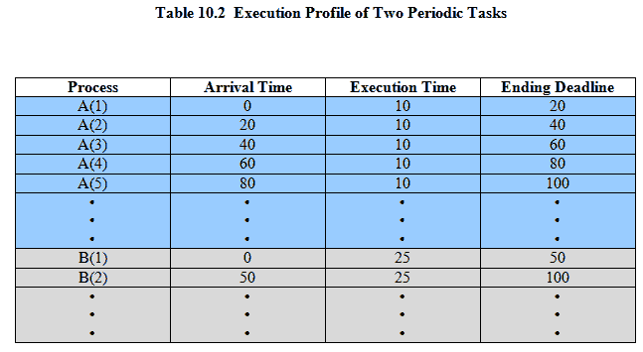
Two Tasks
Notes:
Movie icon links to animation of Periodic with Completion Deadline: http://gaia.ecs.csus.edu/%7ezhangd/oscal/pdeadlineschedulingperiodic.html
As an example of scheduling periodic tasks with completion deadlines, consider a system that collects and processes data from two sensors,A and B.
The dead-line for collecting data from
sensor A must be met every 20 ms,
for B every 50 ms.
It takes 10 ms, including operating system overhead, to process each sample of data from A
and 25 ms to process each sample of data from B.
Table 10.2 summarizes the execution profile of the two tasks.

Slide 48
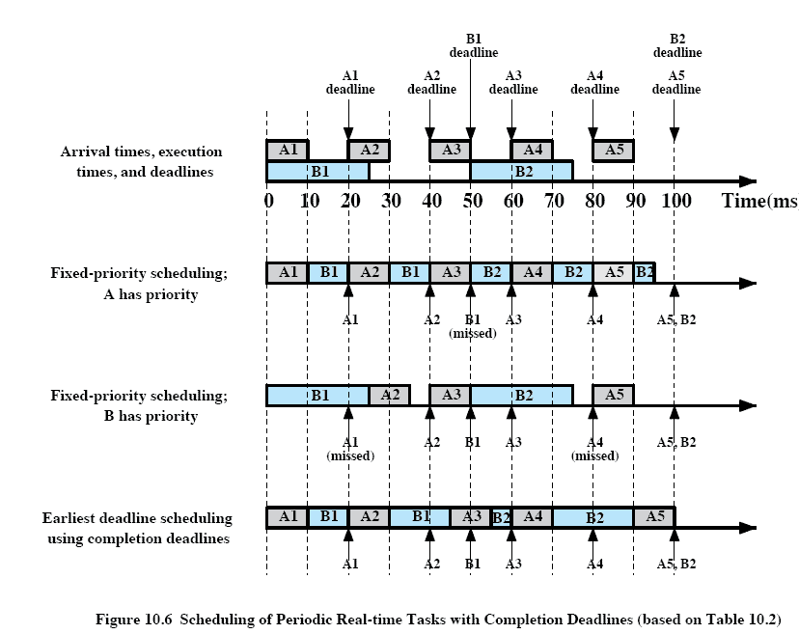
Periodic Scheduling
Notes:
Figure 10.6 compares three scheduling techniques using the execution profile of Table 10.2. (previous slide)
The first row of Figure 10.6 repeats the information in Table 10.2;
the remaining three rows illustrate three scheduling techniques.

Slide 49
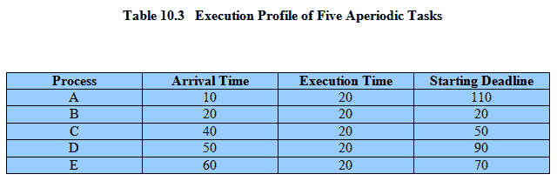
Execution Profile
Notes:
Table 10.3 summarizes the execution profile of the five tasks with starting dead-
lines.

Slide 50
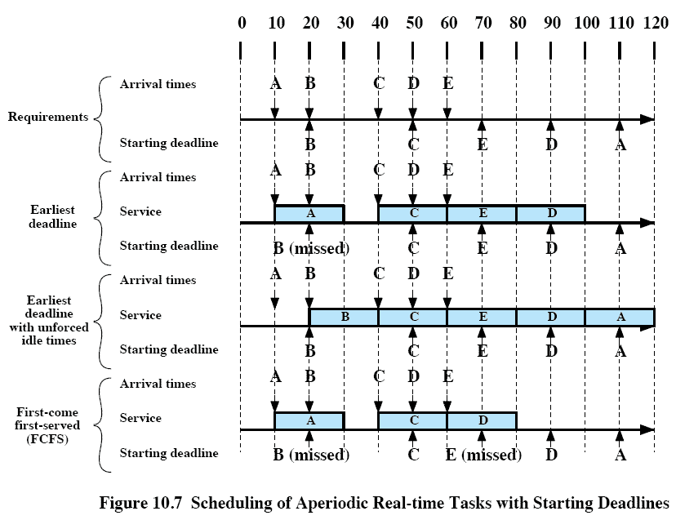
Aperiodic Scheduling
Notes:
Movie icon links to animation of Aperiodic with Starting Deadline: http://gaia.ecs.csus.edu/%7ezhangd/oscal/pdeadlinescheduling.html
The top part of Figure 10.7 shows the arrival times and starting deadlines for an example consisting of five tasks each of which has an execution time of 20 ms.

